Slide 1
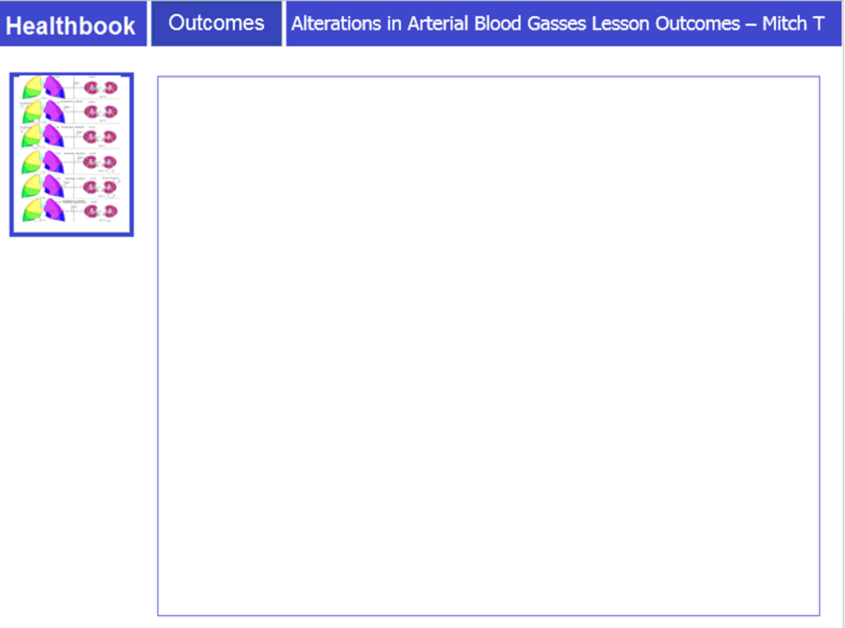
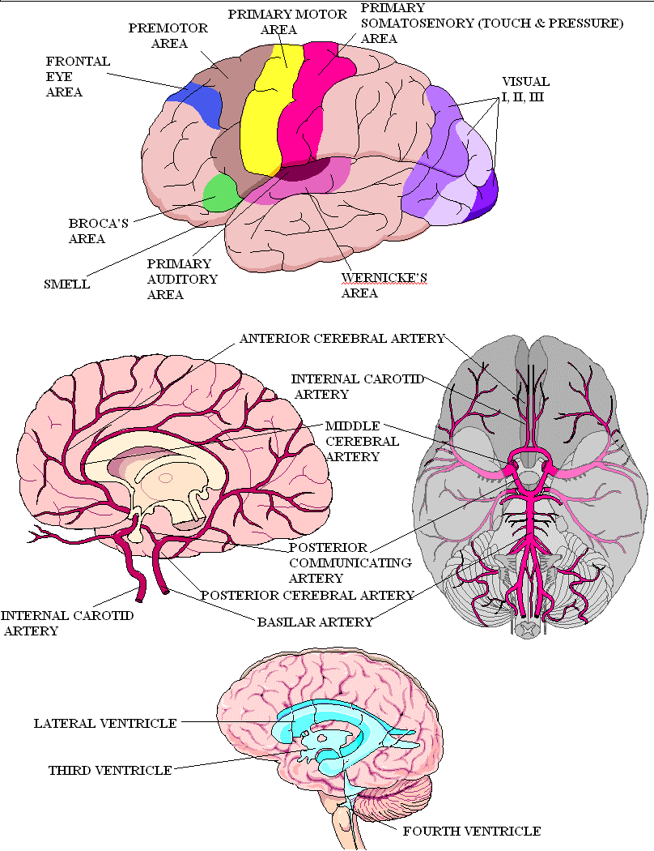
Traumatic Brain Injury – Mitchell Taylor
Following completion of activities, the student should be able to:
Recall the introduction of the concept of Cognition including anatomy and physiology.
Explain the pathophysiology of Traumatic Brain Injury including risk factors.
Explain the role of the nurse in caring for patients with Traumatic Brain Injury having diagnostic testing to assess Cognition status.
What data should I be gathering as part of my assessment related to the pathophysiology?

Slide 2
Traumatic Brain Injury – Mitchell Taylor
Apply knowledge of the pathophysiology to document assessment findings for the patient with Traumatic Brain Injury including Cognition status.
Use nursing judgment to plan safe, evidence-based care to promote safety and maintain Cognition in the Traumatic Brain Injury across the lifespan.
Apply knowledge of pharmacology to delineate nursing implications for administering drug therapy used for patients with Traumatic Brain Injury.
Plan collaborative care to ensure safety and manage Cognition in the patient with Traumatic Brain Injury.
How can I evaluate the effectiveness of my interventions?
Who do I communicate with and how?

Slide 3
Traumatic Brain Injury – Mitchell Taylor
Apply knowledge of pathophysiology to reduce potentially life-threatening complications of Traumatic Brain Injury.
Provide health teaching for the patient and family to manage transitions in care of the patient with Traumatic Brain Injury.
Compare and contrast Cognition across the lifespan.
Josh – A TBI success story – YouTube
Stop at 3:26
What is safe for the pt?

Slide 4
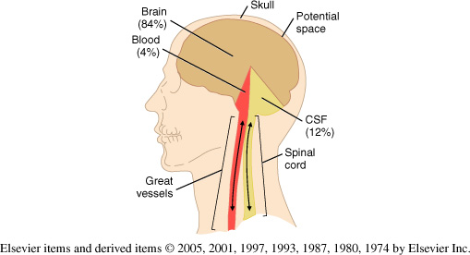
A&P
Traumatic Brain Injury – Mitchell Taylor
Four components to the brain
Skull – cannot expand
Brain
Blood
CSF (Cerebral Spinal Fluid)
Munro-Kellie Hypothesis states
Skull – cannot expand/contract
Other 3 components – if one changes, the other 2 compensate by decreasing in volume
Why is knowing the A&P important?
Why is it important to understand the Munro-Kellie Hypothesis?

Slide 5
A&P
Traumatic Brain Injury – Mitchell Taylor
Munro-Kellie hypothesis-If one changes, the other 2 compensate by decreasing in volume.
First compensation due to swelling from injury or bleeding is displacement of CSF out of the brain and into the spinal canal – only can compensate to a point then ICP will increase.
Second compensation is reducing blood volume to the brain, perfusion to the brain is altered.
Third compensation is no where else to go the brain is forced in to the only opening down into the spinal cord. This is called herniation and produces death.
Why is knowing the A&P important?
Why is it important to understand the Munro-Kellie Hypothesis?

Slide 6
A&P
Traumatic Brain Injury – Mitchell Taylor
Brain – As a vital organ, it needs blood flow or perfusion to keep it alive.
CPP – Cerebral Perfusion Pressure is how we measure that flow to the brain
CPP = MAP – ICP MAP = (SBP + 2XDBP)/3 it will be the number in parenthesis on the monitor next to the BP.
ICP = Intracranial Pressure is the force exerted in the cranial vault by its contents. We are concerned with that pressure on the brain; < 20 mmHg is normal.
Why is knowing the A&P important?
Why is it important to understand the Munro-Kellie Hypothesis?

Slide 7
A&P
Traumatic Brain Injury – Mitchell Taylor
ICP is the pressure on the brain: keep it low < 20 mmHg.
CPP is the blood flow to the brain: keep it high, keep the brain perfused > 60 mmHg.
Explain the concepts and why they are important?

Slide 8
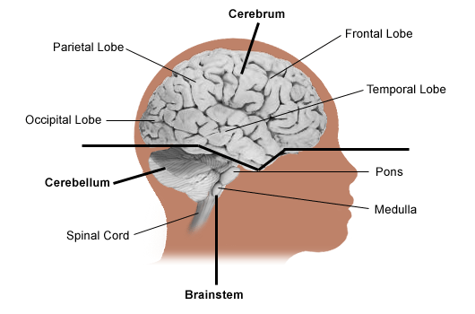
Above is the Cerebrum Below is the Cerebellum and Brainstem
A&P
Traumatic Brain Injury – Mitchell Taylor
This line represents the Tentorial Membrane. Only 2 cranial nerves operate above this level (Supratentorial). CN I – smell and CN 2 – sight
CN III-XII operate
in the
Brainstem.
This is good to know when evaluating for
the source of the lesion.
Why is it important to know the level of the injury?
Why is the brainstem so vital?

Slide 9
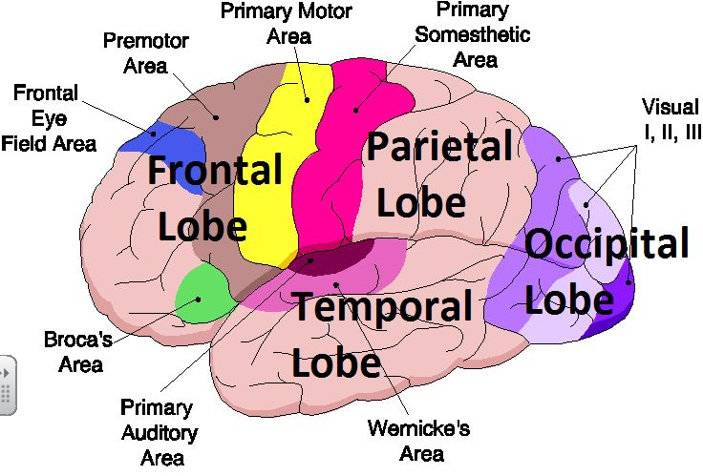
A&P
Traumatic Brain Injury – Mitchell Taylor
Why was Wernicke’s area so important on a previous lecture?

Slide 10
Glasgow Coma Scale
Traumatic Brain Injury – Mitchell Taylor
Eye-opening Verbal Response Motor Response
4 Spontaneous 5 Oriented 6 Obeys command
3 To loud voice 4 Confused 5 Localizes pain
2 To pain 3 Inappropriate words 4 Withdraws from pain
1 None 2 Incomprehensible words 3 Flexion from pain
1 None 2 Extension from pain 1 None
This assessment scale helps to quantify changes and identify worsening symptoms for treatment. Decorticate posturing is considered flexion on the scale. Decerebrate is considered extension. I always remembered Decerebrate as celebrate (extend arms to celebrate) to remember which is which.
Other changes seen can be in one sided weakness, facial drooping, nausea, vomiting, hyperthermia, headaches, hypoxia, Cheyne-Stokes Respirations, Cushing’s Triad (late sign of high ICP) – of increased SBP, widening pulse pressure, and bradycardia.
Why is it important to do this assessment consistently?
What would be the implications of each deficit?

Slide 11
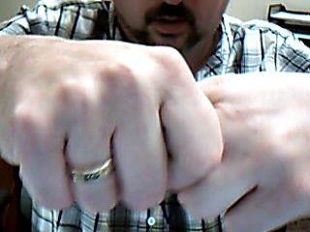
Changes
Traumatic Brain Injury – Mitchell Taylor
Glasgow Coma Scale – (assessment)
Point of maximum stimulation, so sleeping is not a neuro. deficit. If they are awakened, the patient should be able to respond appropriately. Pinching around axilla, sternal rub, pinching nail bed with Kelly clamp, ice water to ear canal are all ways to stimulate a comatose patient.
Clamping your fingers may be reflexive but releasing would not be.
Have the patient give a thumbs up to follow directions.
Always perform as a baseline before procedures or movement.
Which is more important to chart or pass on in report, the normal or the abnormals?
Can the patient repeat the task?

Slide 12
Changes
Traumatic Brain Injury – Mitchell Taylor
Symmetry of movement and strength checked
Pupil size and response checked
Babinski sign – stimulation to the bottom of the foot should be negative in adults, toes do down – positive, toes go up and fan out, indicating altered perfusion to cerebral cortex.
How many hands are required to check symmetry of strength?
Practice on your friends to show it properly

Slide 13
Classic Signs
Traumatic Brain Injury – Mitchell Taylor
Headache – usually severe
Early changes in mental state include lethargy, irritability, slow decision making and abnormal social behavior. Untreated, can deteriorate to stupor, coma and death.
Vomiting (in early stages without nausea) and can progress to projectile with rising ICP.
Pupil changes including irregularity or dilatation in one eye.
The best indicator of deterioration in a patient with traumatic brain injury is change in:
a. breathing
pattern
b. heart rhythm
c. skin color
d. blood
pressure
e. level of
consciousness

Slide 14
Classic Signs
Traumatic Brain Injury – Mitchell Taylor
Fundoscopy shows blurring of the disc margins, loss of venous pulsations, flame-shaped hemorrhages. In later stages, may see obscured disc margins and retinal hemorrhages.
Late signs include motor changes (hemiparesis), raised systolic arterial pressure, widened pulse pressure and slow irregular pulse.
‘Talk and deteriorate’ patients typically talk recognizably following head injury then go into coma in the first two days. Usual cause is an intracranial hematoma.
You know that spine immobilization cannot be removed until:
48 hours have passed
The neurological status has stabilized
Patient is ready for discharge from the Intensive Care Unit (ICU)
Injury to the spine has been ruled out

Slide 15
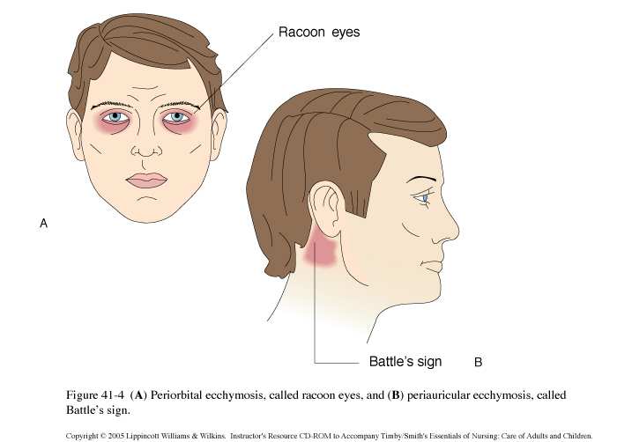
A&P
Traumatic Brain Injury – Mitchell Taylor
Which of the following observations are relevant to a basilar skull fx?
Select all that apply:
-Leakage of cerebrospinal fluid (CSF) from the nose or ear
-Raccoon sign
-Battle's sign
-Babinski's sign
-Kernig's sign
-Brudzinski's sign

Slide 16
Reflection
Traumatic Brain Injury – Mitchell Taylor
The nurse is caring for a client after a head injury. Which assessments are concerning to the nurse? SELECT ALL THAT APPLY
ICP of 22 mmHg -
CPP of 55 mmHg -
Sudden vomiting -
Personality changes -
Negative Babinski test
The nurse is caring for a client who will have a cerebral angiogram done this morning. Which assessments would the nurse do prior to going to the procedure? SELECT ALL THAT APPLY
Get a BUN and Creatinine -
Assess pedal pulses -
Check a blood sugar -
Make the client NPO -
Perform a baseline neuro assessment -

Slide 17
Case Study
Traumatic Brain Injury – Mitchell Taylor
A 22 year old comes into the ER with MVC (motor vehicle crash) at 6:30am. Patient was not wearing a seat belt. Patient lost control and hit a tree going about 30mph.
Initially patient lost consciousness at the scene and was given a Glasgow Coma Score of 3 and then 14 as patient began to wake.
Patient is transported to the ER with a Glasgow Coma Score is given of 15.
What is the priority assessment initially and why?

Slide 18
Case Study
Traumatic Brain Injury – Mitchell Taylor
Patient is placed on a nasal cannula to maintain oxygenation at 4L.
A rigid C-collar is placed on the patient’s neck and spinal precautions are maintained.
What does spinal precautions mean and how do you turn patients?
Any assessment needed prior to turning patients?

Slide 19
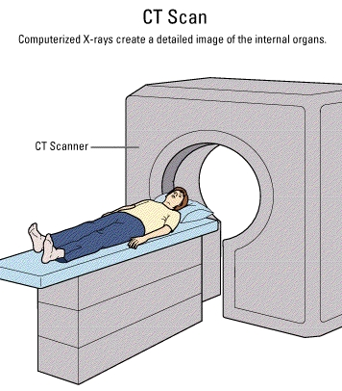
A&P
Traumatic Brain Injury – Mitchell Taylor
A CT scan is done without contrast to the head to look for any gross bleeding or abnormalities.
Important to rapidly get the patient to a noncontrast CT.
Important to leave C-Collar on and no pillow.
How is getting a CT scan going to help us?
With all this movement, what assessments and evaluations need to be done?

Slide 20
Case Study
Traumatic Brain Injury – Mitchell Taylor
A small subdural hematoma is reportedly found on the CT scan in the right temporal area.
Can you predict the options that might be done for this patient?

Slide 21
Case Study
Traumatic Brain Injury – Mitchell Taylor
Patient is to be transported to your unit in SICU at change of shift 7:30am.
Report is called to you.
A neurosurgeon has been consulted to see if surgery is an option to remove the blood by craniotomy.
The neurosurgeon is on the way and will evaluate the patient in SICU.
Your first assessment at 8am, shows a 15 on the Glasgow Coma Scale. Symmetry of movement and strength bilaterally, and PERRLA +3/Brisk +3/Brisk reaction to the pupils.
What would be important in report to take note?
What interventions are important if patient is going to surgery?

Slide 22
Glasgow Coma Scale 8 am
Assess
Traumatic Brain Injury – Mitchell Taylor
What teaching can be done for the patient and family?

Slide 23
Case Study
Traumatic Brain Injury – Mitchell Taylor
Patient is wanting to get up and drink some water.
Patient education: Reverse Trendelenburg position is provided and explained to the patient that until the neck can be cleared, the same trauma that caused the bleed could have caused a small fracture to the neck. It is important to stay in alignment until that is checked or the patient can cause spinal cord injury and possibly paralysis.
Also maintaining the patient NPO until Neurosurgeon decides if will go to surgery or not is important to not risk the chances of aspiration.
Patient and family verbalize understanding.
Why is it important to not get up?
Why is it important to remain NPO?

Slide 24
Case Study
Traumatic Brain Injury – Mitchell Taylor
At 9am, no change on the Glasgow Coma Scale, still a 15.
The Neurosurgeon is evaluating the patient for surgery and talking to patient and family.
Cervical, Thoracic, and Lumbar spinal films are done and awaiting to be evaluated by the Trauma physicians.
The patient is becoming more agitated with the C-collar and wants to get up.
What are the red flags and what do they indicate to you?

Slide 25
Case Study
Traumatic Brain Injury – Mitchell Taylor
The neurosurgeon tries to explain the importance of maintaining spinal alignment.
The nurse called the Trauma doctor and they report that it is ok to let the patient sit up, but still want the patient to be NPO and keep the C-Collar on. This is told to the patient which is ok and sits up with C-Collar on.
The neurosurgeon asks to monitor the patient hourly for neuro-checks and to call with changes.
Why is communication and collaboration important?

Slide 26
Case Study
Traumatic Brain Injury – Mitchell Taylor
At 10am, the Glasgow Coma Scale is 12. Patient only opens eyes to speech, localizes to pain, and is confused with speech. The RN notifies the Neurosurgeon of the changes, a stat CT scan is ordered without contrast. Left pupil is larger than Right pupil, (CN-III).
RN notifies the Trauma doctor as well of the changes. Order for intubation. Anesthesia on call is called for stat intubation and Respiratory Therapy is called for a ventilator.
Back to CT, why and what assessments need to be done prior to leaving and after getting back?

Slide 27
Glasgow Coma Scale
Traumatic Brain Injury – Mitchell Taylor

Slide 28
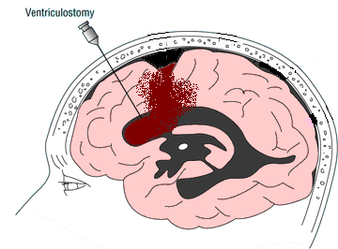
Case Study
Traumatic Brain Injury – Mitchell Taylor
The CT scan is done and report from radiology called to the Neurosurgeon.
The Neurosurgeon calls the RN and states the bleed is worse and to set up for a Ventriculostomy and ICP monitor. The physician hopes to be
able to place a catheter
into the ventricles of the brain to drain off CSF
and monitor ICP.
Speculate on who needs to be contacted and what needs to be communicated and what preparations need to be made.

Slide 29
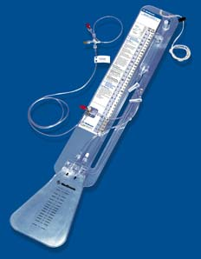
Ventriculostomy Drainage System
Ventriculostomy
Traumatic Brain Injury – Mitchell Taylor
Zeroed at the tragus. After drain is placed by the physician, attach the drainage system and level at ordered measurement.

Slide 30
Case Study
Traumatic Brain Injury – Mitchell Taylor
Consent from family is obtained and the Ventriculostomy is placed (initially 150 mL of blood tinged fluid comes out). ICP is 45, initially with a MAP of 85. The CPP is MAP-ICP = 40.
Neuro. protocols ordered by the Trauma physician.
Patient started on Fluid boluses of NS, then Dopamine, then Norepinephrine, then Phenylephrine (Neo-synephrine) to get CPP > 60 mmHg. Mannitol is given to reduce ICP, Foley is placed to monitor urine output.
After 1 hour another 80 mL comes out. ICP is down to 22. CPP is up to 72.
Look up each of these drugs – What is the purpose of these drugs?

Slide 31
Reflection
Traumatic Brain Injury – Mitchell Taylor
The nurse is caring for a client with an ICP of 36 mmHg. Which actions by the nurse will help? SELECT ALL THAT APPLY
3% Sodium Chloride -
Hydromorphone -
D5 ½ Normal Saline
Propofol -
Mannitol -
The nurse is caring for a client with an CPP of 55 mmHg. Which actions by the nurse will help? SELECT ALL THAT APPLY
Milrinone
0.33% Sodium Chloride
IV fluid bolus of NS -
Norepinephrine -
Dopamine -

Slide 32
Pharm
Traumatic Brain Injury – Mitchell Taylor
Mannitol or hypertonic solutions like 3%NS or 7% NS – hyperosmotic diuretic, pulls fluid out of the cells into the vascular space and patients urinate out the extra fluid. Make sure you don’t dehydrate these patients. Check serum/urine osmolarity.
Sedation/Pain meds may be given (after patient unresponsive – if high ICP) initially it might not be given if patient is awake as to not interfere with evaluation of LOC.
Distinguish between treating pressure on the brain versus perfusion to the brain.

Slide 33
Pharm
Traumatic Brain Injury – Mitchell Taylor
Pain – Opiates like Morphine or Hydromorphone (Dilaudid-about 4 times as potent as Morphine) fentanyl. Demerol is a contraindication in head injury patients, removed from most formularies. Watch resp. depression and low BP. Antidote - Naloxone is a drug used to counter the effects of opioid overdose (ketamine – may increase ICP and cause seizures so in TBI may be of limited use)
Sedation – Versed or Ativan benzodiazepines are a class of drugs with sedative, hypnotic, anxiolytic, anticonvulsant, amnestic and muscle relaxant properties. Watch resp. depression and low BP. Antidote -Flumazenil (Romazicon) is a benzodiazepine antagonist.
When is pain medicine not ok to give patients?

Slide 34
Mech Vent.
Traumatic Brain Injury – Mitchell Taylor
Propofol is a short-acting intravenous anesthetic agent used for the induction of general anesthesia in adult patients and pediatric patients older than 3 years of age; maintenance of general anesthesia in adult patients and pediatric patients older than 2 months of age; and sedation in medical contexts, such as intensive care unit (ICU) sedation for intubated, mechanically ventilated adults, and in certain procedures. Watch for low BP.
A newer sedative is Precedex (dexmedetomidine) is an IV sedative and is the first and only alpha2 agonist indicated for sedation
May use BIS (Bispectral Index Monitoring) to determine how sedated a patient is on a monitor.
Patient may need sedation holiday, daily.
Which drug needs mechanical ventilation?

Slide 35
Seizures
Traumatic Brain Injury – Mitchell Taylor
Benzodiazepines – common Versed (midazolam), Ativan (lorazepam), Valium (diazepam)
Phenytoin - like:
Phenytoin (Dilantin) – very caustic to vessels, can cause tissue destruction, make sure you get a good blood return if giving in a peripheral site. Often not seen any more but is an old heart antiarrhythmic and can cause low BP.
Fosphenytoin (Cerebyx)
Carbamazepine (Tegretol)
Valproic Acid (Depakene)
Phenytoin and fosphenytoin can produce what adverse effects?

Slide 36
Case Study
Traumatic Brain Injury – Mitchell Taylor
At this point we need to maintain some things. Realistically, we need help from the charge nurse to take or have someone else monitor our other patient.
Delegate responsibilities of recording vital signs, placing SCDs on patient, dumping and recording urine hourly, hourly accu-checks to monitor Blood Sugars. Many of these patients will be on insulin drips that you regulate, but the monitoring of BSs can be delegated.
Communicate well with patient, family, respiratory therapy (they will be managing your ventilator), physicians, lab, and diagnostic procedures.
Goal is to prevent any other injuries like pneumothorax from intubation, infections and blood clots from immobility and being on a ventilator, pressure sores, malnutrition or decreased perfusion to the GI tract, hypoxia, hypovolemia from using Mannitol as a hyperosmotic diuretic to pull off fluid.
What does nursing judgement mean to you?
What teaching needs to be communicated?
Delegation: how do you delegate – see Decision Tree poster

Slide 37
Secondary Injuries
Traumatic Brain Injury – Mitchell Taylor
Monitor vital signs
Monitor bedside blood glucose levels
Monitor for signs of responsiveness
Monitor for signs of infection
Monitor labs including serum osmolarity for dehydration if using osmotic diuretics and ABGs for acid/base imbalance that may affect ICP
Prevent blood clots by placing of SCDs/foot pumps
Prevent gastric irritability with proton pump inhibitors or H2 blockers
Monitor for and prevent seizures
Monitor and prevent hyperthermia
What limits go with each of these?

Slide 38
Goals
Traumatic Brain Injury – Mitchell Taylor
Goal is to maintain an open airway – keep patient NPO and call for orders to get patient intubated if unable to support own airway
Goal is to decrease ICP < 20 mmHg
Meds (hypertonic solutions-draws fluid into vessel)
Elevate HOB, keep quiet/dark, reduce pain
Goal is to raise CPP > 60 mmHg
Mainly by increasing BP- (dopamine, norepinephrine, phenylephrine, start 1 then add)
Goal is to raise or maintain GCS 14-15.
Draw a concept map of a patient with a head injury

Slide 39
Goals
Traumatic Brain Injury – Mitchell Taylor
Temperature will be maintained at less than 38.5 Celsius (101.3F).
Maintain urine output > 30mL/hr and not >200mL/hr (may indicate diabetes insipidus)
Keep HOB up 30-45 degrees if not contraindicated
Monitor for changes in Neuro status
What is diabetes insipidus and what is the treatment?

Slide 40
Last Efforts
Traumatic Brain Injury – Mitchell Taylor
Phenobarbital causes a "depression" of the body's systems, mainly the central and peripheral nervous systems; thus, the main characteristic of phenobarbital overdose is a "slowing" of bodily functions, including decreased consciousness (even coma), bradycardia, bradypnea, hypothermia, and hypotension (in massive overdoses). Overdose may also lead to pulmonary edema and acute renal failure as a result of shock.
The electroencephalogram (EEG) of a person with phenobarbital overdose may show a marked decrease in electrical activity, to the point of mimicking brain death. This is due to profound depression of the central nervous system, and is usually reversible.
If brain death is suspected, then this drug has to be stopped and let out of the system before a patient can be pronounced dead.
What if ICPs are still high?

Slide 41
Paralytic
Traumatic Brain Injury – Mitchell Taylor
A paralytic may be required to prevent any movement.
Must be mechanically ventilated.
They can still feel everything, so sedation/pain medication needs to be given prior to and concurrent with administration.
Nondepolarizing blockers
Atracurium (Tracrium)
Vecuronium (Norcuron)
Rocuronium (Zemuron)
Cisatracurium (Nimbex) – eliminated through resp. system – favored because not eliminated through the kidneys or liver.
Depolarizing blocker
suxamethonium (succinylcholine) – very short duration – 5 minutes. Favored by some for short duration for procedures such as intubation.
What can the patient feel when chemically paralyzed?

Slide 42
Train of 4
Traumatic Brain Injury – Mitchell Taylor
Train of Four is used to determine twitches on the ulnar nerve or at near the eyebrow for patients on a paralytic.
4 light shocks are given causing the paralyzed person to twitch 3-4 times. Paralytic would need to be increased.
2 twitches out of 4 would be no change in paralytic.
1 twitch out of 4 would be a need to decrease paralytic according to protocol orders.
Train of four vs BIS monitoring: when to do which?

Slide 43
Vasospasms
Spasms
Traumatic Brain Injury – Mitchell Taylor
Nimodipine - Nimotop is a calcium channel blocker originally developed for the treatment of high blood pressure. It is not frequently used for this indication, but has shown good results in preventing a major complication of subarachnoid hemorrhage, vasospasm
This is now the main use of nimodipine.
Also seen given after a craniotomy, cerebral arteriogram or aneurysm clipping or repair.
Watch for this after what conditions and after what procedures?

Slide 44
Surgery
Traumatic Brain Injury – Mitchell Taylor
A craniotomy is the surgical removal of a section of bone (bone flap) from the skull for the purpose of operating on the underlying tissues, usually the brain. The bone flap is replaced at the end of the procedure. If the bone flap is not replaced, the procedure is called a craniectomy. A craniotomy is used for many different procedures within the head, for trauma, tumor, infection, aneurysm, etc.
What education to the family is important prior to the procedure?

Slide 45
Craniotomy
Surgery
Traumatic Brain Injury – Mitchell Taylor
As with any post-op surgery, closely monitoring vital signs is important.
Patient will come back, generally with a head wrap dressing, face very swollen (this will go down in 2-3 days), and may be very lethargic if they are responsive at all.
Good neurological checks, a baseline neuro-exam before any procedure will help identify changes afterwards. These patients need to be stimulated to be awakened every hour to check neurological status.
Let the surgeon know of any deteriorating changes in neurological status, even if slight.
What are you looking for to evaluate when a patient comes back from surgery and a surgery involving the brain?

Slide 46
Tests to determine brain death.
Tests
Traumatic Brain Injury – Mitchell Taylor
Apnea testing: When taken off the vent and CO2 builds up a person will breath if they have basic brain activity. It is not a conscious effort. If a patient fails to breath with an elevated CO2 and low O2, then brain death can be pronounced.
Blood flow to the brain has to be completely absent to pronounce brain death.
Keep the rest of organs perfused and may be a good donor for organ retrieval.
Is a patient brain dead with a RR of 15 if the ventilator rate is set at 12?
Why or why not?

